Slide 1
Project Presentation of Book Management System
By : Pratik Baishnav
Course : B.Sc.IT 6th
University Roll : 551217295

Slide 2
Statement of The Problem
The Scope of the application is wide and can be used with any education institute and also can be used in offices with the necessary modifications done.
With this application, the manual application is converted into automated desktop application.

Slide 3
Objective and Scope of The Project
The purpose of this system is to support teaching, learning and research in the Education Sectors and in the Offices as per the need, by developing and promoting access to information resources.
Helps to create a friendly environment between different users and staff personnel.
The three major components in the application are: -LOGIN -ISSUE BOOK -RECEIVE BOOK

Slide 4
Why is The Particular Topic Chosen?
Better and efficient service can be provided
Faster retrieval of information
Reduced workload of the library staff
All details of the book will be available on a click
Less paper work and document maintenance

Slide 5
Methodology
The system supports the selection and implementation of Book Management System.
A brief review of the nature and components of this system is offered as a basis.
The proposed methodology is drawn from established library systems methodologies and from the literature on computer-based library systems.
Tools take the form of a series of checklists covering issues to be considered at various stages in the project.

Slide 6
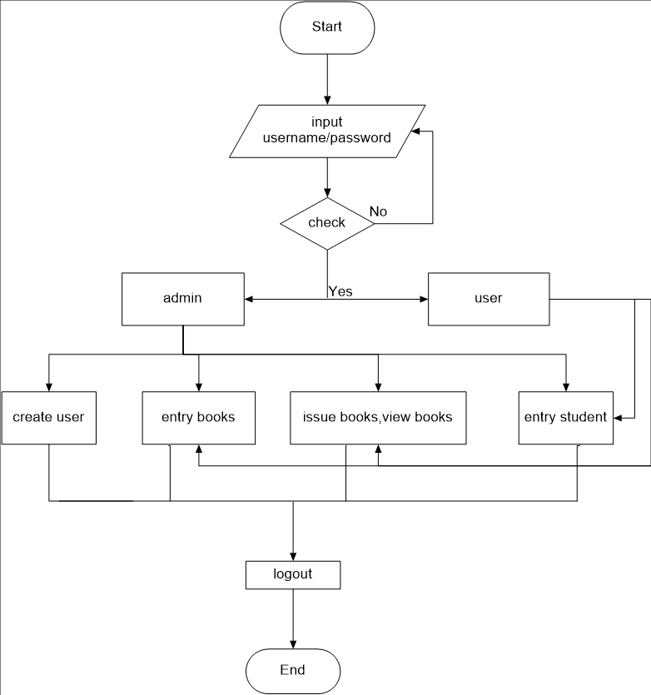
Flow Chart

Slide 7
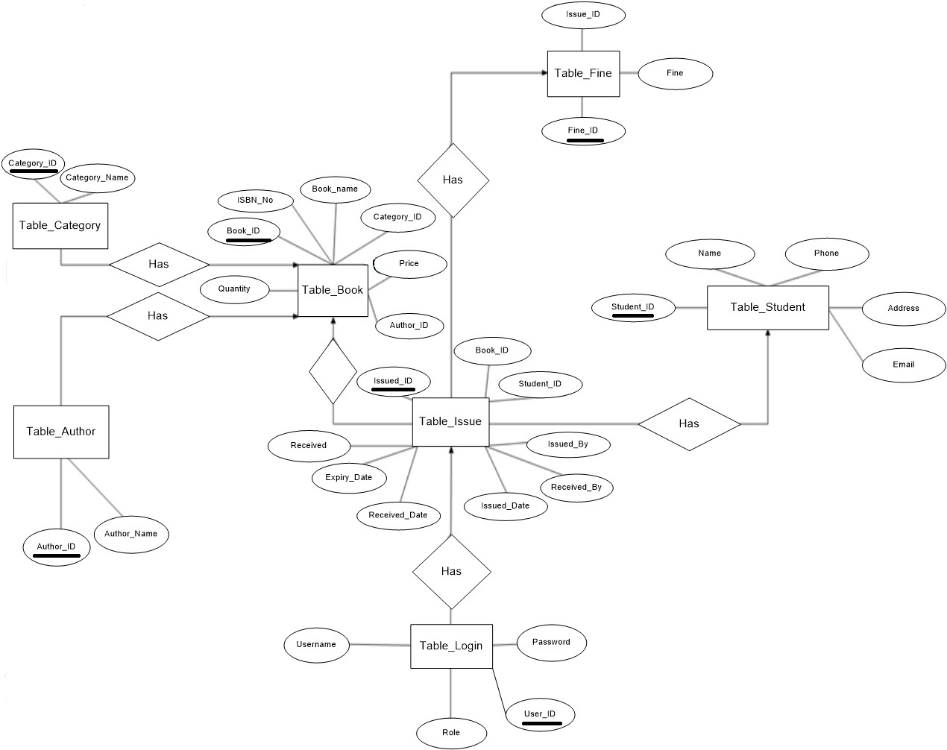
E-R Diagram

Slide 8
Requirements
Hardware
A Pentium 4 computer or higher.
2GB RAM for smooth environment.
Intel Processor or any other.
Software
Visual Studio 2012
SQL SERVER 2008 R2

Slide 9
Components of the System
Front End
C#.NET
Back End
SQL SERVER

Slide 10
Brief Overview
In overall this system allows admin and users to issue books to the students.
It deals with various functions like insert, update, view and delete of books.
In short this system is a friendly interface designed to carry out its task in a simple manner.

Slide 11
Thank You !!!!

